Slide 1
Staying Safe in 2019: What you need to know about mental health effects of weed, what you need to know about opiates
By Amir Barsoum
Feb 5, 2019

Slide 2
Objectives
To learn about and gain an understanding of:
what cannabis is and how it acts in the brain
one of the most serious side effects of cannabis (psychosis)
what has led to the opioid crisis and why it is so serious

Slide 3
Cannabis
Derived from cannabis plant
marijuana/“weed”/“pot” consists of dried leaves/buds, can be smoked or taken orally
can also be taken in other forms, such as oil
Active ingredients: THC (creates the “high”), CBD (therapeutic effects?), and dozens of others, not yet researched…
Notes:
religious/medicinal/recreational use dates back 5000 years THC structure became known in 1960’s
cannabinoid receptors in the brain discovered in 1980’s
first endogenous cannabinoid, anandamide, discovered in 1992

Slide 4
The Endocannabinoid System
We all have cannabinoid receptors on our brain cells
We all produce endocannabinoids naturally in our brain (eg. anandamide)
Cannabinoids interact with cannabinoid receptors like a lock and key
They regulate many functions including pleasure, pain, appetite, memory, motivation, temperature regulation, and neurodevelopment.
Notes:
“The volume control of the neuron”
fine tune many of our vital physiological functions
temperature regulation, inflammation
very intricate very finely tuned
dopamine is involved in experience of pleasure, and the endocannabinoid system helps to regulate this
examples of normal cannabinoid function: enjoyment and craving for certain foods; the “runner’s high”

Slide 5
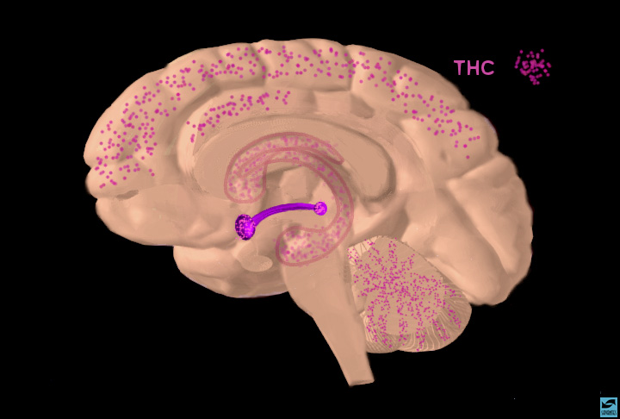
The Endocannabinoid
System
(Picture from NIDA website)
Notes:
Slide 21: Localization of THC binding sites
When a person smokes marijuana, the active ingredient, a cannabinoid called THC, travels quickly to the brain. Point to the areas where THC (magenta) concentrates. The VTA, nucleus accumbens, caudate nucleus, hippocampus, and cerebellum are highlighted. THC binds to THC receptors that are concentrated in areas within the reward system as well as these other areas. Indicate that the action of THC in the hippocampus explains its ability to interfere with memory and actions in the cerebellum are responsible for its ability to cause uncoordination and loss of balance.

Slide 6
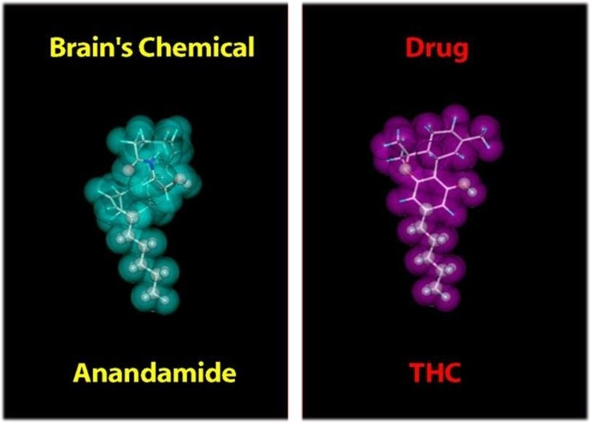
Tricking the brain…
Picture taken from NIDA
Notes:
Endogenous cannabinoids vs exogenous cannabinoids (vs synthetic cannabinoids)

Slide 7
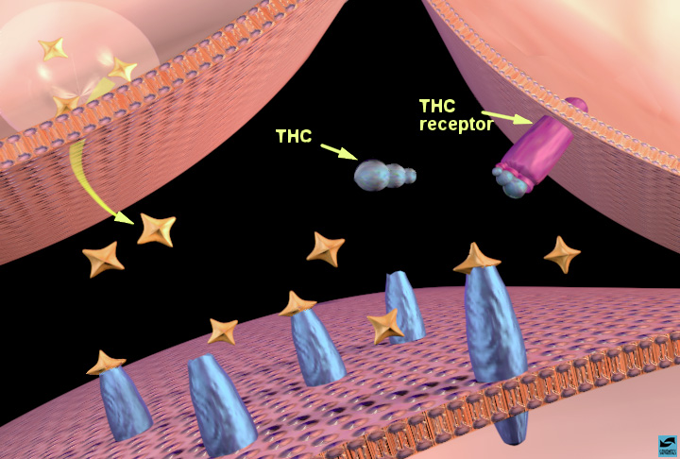
Taken from NIDA
Notes:
Slide 22: THC binding to THC receptors in the nucleus accumbens: increased dopamine release
[Note to scientists - the interaction of THC with the reward system is not fully understood at this point. The following discussion is based on recent data, but additional theories may emerge as we obtain more data.] State that scientists know the least about THC. Over the last few years, there has been intense study to discover where and how THC works. One theory is that it acts in a similar way to opiates. Again use the nucleus accumbens as an example. The same three neurons are probably involved: the dopamine terminal, another terminal (on the right) containing a different neurotransmitter (probably GABA), and the post-synaptic cell containing dopamine receptors. Ask the students if they can tell you how THC might work. THC binds to THC receptors (magenta) on the neighboring terminal and this sends a signal to the dopamine terminal to release more dopamine. [Again, it is probably a presynaptic receptor on GABA interneurons that controls dopamine release.]

Slide 8
THC vs Anandamide
THC is more potent and longer lasting than anandamide.
THC stimulates the dopamine reward system to a greater degree resulting in sensation of euphoria
An unintended side effect of excess dopamine in the brain is PSYCHOSIS
Effects on neurodevelopment?
Notes:
Brain is not fully developed until age 25

Slide 9
Psychosis
Overactivity in the mesolimbic dopamine pathway leads to psychosis
Somebody’s poisoned my food.
I hear people talking about me.
A chip has been implanted in my brain to read my thoughts.
I keep seeing the colour blue, and I know it’s the devil telling me I’m bad.
Thousands of people died in another part of the world because of a thought that I had.
Notes:
psychosis — excess dopamine activity in the mesolimbic pathway, “salience”

Slide 10
How long does drug-related psychosis last?
Drug-related psychosis may be:
transient: persists only during the course of drug intoxication (most common)
persistent: persists beyond the period of intoxication, but resolves on its own, usually without medication
?permanent, i.e. schizophrenia: does not resolve without medication, usually requires lifelong medication

Slide 11
Adolescent cannabis use and schizophrenia
Andreason et al (1987), 45,570 Swedish Conscripts over 15 years, then 27 years (2002)
Arseneault et al (2002), 1037 New Zealand subjects, over 15 years
van Os et al (2002), 4104 Dutch subjects, over 3 years
Fergusson et al (2003) 1265 New Zealand subjects over 3 years
Henquet et al (2005), 2437 German subjects, over 4 years
Studies consistently show a 2-3x increased risk of developing schizophrenia in those who use cannabis before age 18. Risk increases with earlier age of use and higher frequency of use.
Notes:
Andreasson:Controlled for confounding factors: IQ sore, disturbed behavior in childhood, psychiatric diagnosis at conscription, cigarette smoking, degree of social integration, and place of upbringing
Did not control for use of other drugs
All show 2-3 x risk of developing schizophrenia in those who use cannabis before age 18. Risk increased with earlier age of use and with higher frequency of use.

Slide 12
Adolescent cannabis use and schizophrenia
marijuana is likely not “causing” schizophrenia, but rather triggering it in vulnerable individuals
at this time there is no way to know who is vulnerable
earlier onset of schizophrenia is associated with poor outcome, as is substance abuse + schizophrenia

Slide 13
Cannabis and psychosis — Summary
Cannabis use frequently causes transient psychosis by increasing dopamine levels in the brain
Early cannabis use can be a risk factor for schizophrenia
Cannabis use should be avoided in individuals under age 18

Slide 14
Opioids
a class of drugs chemically related to opium
used in medicine to alleviate pain; used recreationally to induce euphoria
Examples: morphine, codeine, oxycodone, hydromorphone, heroine, fentanyl
Notes:
Opiates vs opioids
Narcotics

Slide 15
Opiate misuse has become more widespread since prescription opiates and synthetic opiates became more widely available in the 1990’s
9 hospital admissions per day for opiate poisoning in 2008 vs 17 in 2017
2861 opiate-related overdose deaths in 2016 (7.9/100,000), vs 4000 in 2017
BC and Alberta — 42 fatal fentanyl overdoses in 2012, 418 in 2015
Notes:
2 to 14, 700% fold increase
under 18 1%, but 0.1 % heroine, perception less harmful, 40X risk of general pop’n of becoming heroine addicts

Slide 16
Opioid-related harms and deaths in Canada
3005 opioid related deaths in 2016 (8.3 per 100,000 population), 55% involved fentanyl
3996 opioid related deaths in 2017 (10.9 per100,000), 72% involved fentanyl
2066 opioid related deaths from Jan-Jun 2018 (11.2 per 100,000)
Between 2016 and 2017, ER visits for opioid poisonings increased by 73% in Ontario, 23% in Alberta
Source: Public Health Agency of Canada

Slide 17
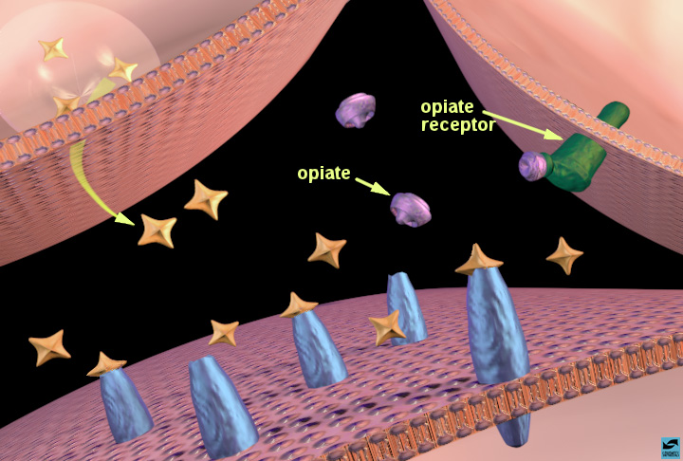
Taken from NIDA
Notes:
Slide 18: Opiates binding to opiate receptors in the nucleus accumbens: increased dopamine release
Show how opiates activate the reward system using the nucleus accumbens as an example. Explain that the action is a little more complicated than cocaine's because more than two neurons are involved. Point out that three neurons participate in opiate action: the dopamine terminal, another terminal (on the right) containing a different neurotransmitter (probably GABA for those that would like to know), and the post-synaptic cell containing dopamine receptors. Show that opiates bind to opiate receptors (green) on the neighboring terminal and this sends a signal to the dopamine terminal to release more dopamine. [In case an inquisitive student asks how, one theory is that opiate receptor activation decreases GABA release, which normally inhibits dopamine release, so dopamine release is increased.]

Slide 18
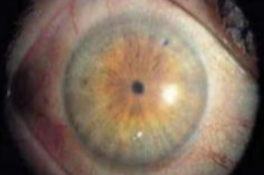
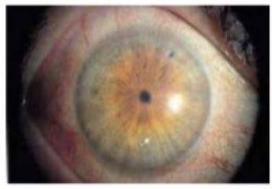
Short Term Effects of Opioid Use
Pain relief
Feelings of euphoria
Drowsiness
Pinpoint pupils
Paranoia
Nausea
Constipation
Notes:
dif people experience dif degrees of responses, some more positive, some more negative

Slide 19
Opioid Overdose
Drowsiness, Confusion
Coma
Respiratory Depression
Death
Risk factors: loss of withdrawal, use of high potency synthetic opioids

Slide 20
Opioid Withdrawal
within 6-12 hours for short-acting opiates, 30 hours for longer acting opiates
muscle aches, depression, anxiety/agitation, tearing/runny nose, pupil dilatation, sweating, nausea, diarrhea, fever, insomnia
Notes:
Very painful, uncomfortable, fatal if cv cond’n, not otherwise

Slide 21
Challenges in Opioid Addiction
Loss of tolerance can lead to accidental overdose
High potency synthetic opioids present a higher risk of accidental overdose
Relapse rates following residential treatment as high as 90%
Factors contributing to relapse: withdrawal, craving, abnormal stress response

Slide 22
Opioid Agonist Treatment
Involves replacing the opioid with one of two options:
methadone — a long-acting opioid that when used properly does not cause euphoria
buprenorphine (suboxone) — a “partial agonist” — has minimal agonist activity on the receptor, carries least risk of overdose

Slide 23
Opioid agonist therapy
is NOT replacing one addiction with another
works by eliminating the cycle of euphoria and withdrawal, reducing cravings, and restoring normal stress response
Canadian guidelines for management of opioid use disorder (CMAJ, March 2018) recommend opioid agonist treatment as first line therapy

Slide 24
In Summary…
Opioid addiction is a chronic, life-threatening condition, which often begins with prescription opioid tablets
Opioid addiction may cause longterm changes in brain function and in stress response
2018 Canadian clinical guidelines recommend opiate agonist treatment as a first line treatment, particularly buprenorphine (Suboxone) where possible

